Slide 1
Customer retention case Study
Sahil Kumar (Internship Batch 24)

Slide 2
Table of contents
Introduction
Problem Statement
Problem Understanding
Understanding Customer Retention
Exploratory Data Analysis
Visualizations and Outcomes
Assumptions and Recommendations
Conclusion

Slide 3
introduction

Slide 4
INTRODUCTION
With the rapid global growth in electronic commerce (e-commerce), businesses are attempting to gain a competitive advantage by using e-commerce to interact with customers.
Consumers are increasingly going online to buy goods and services, get product information, or just browse for fun. As a result, online shopping environments are becoming more important in the overall connection between marketers and their customers.
We will look at the client retention rate for Indian e-commerce enterprises in this presentation.

Slide 5
Problem statement

Slide 6
Problem statement
The rate of online purchasing is increasing each day. The satisfaction of customers is critical to every company's business growth. "What unique elements encourage a consumer to purchase online as well as hinder a buyer from purchasing online?" is the first question that comes to mind.
To say that customer satisfaction is important is an understatement. In 2022, it’s a necessity. According to Gartner, 81% of marketers view customer satisfaction as the main competition area in their industry.
Service quality, system quality, information quality, trust, and net benefit have been identified as vital characteristics that contributed to the success of an e-commerce store. The study also investigated the elements that influence the likelihood of repeat purchases by internet clients. To positively influence repeat purchase intention (loyalty), a combination of utilitarian and hedonistic values is required. The information was gathered from Indian online shoppers. The findings reveal the e-retail success characteristics that are crucial for client happiness.

Slide 7
Problem understanding

Slide 8
Problem understanding
The problem statement looked at how customers create expectations about the quality of technology-based self-service and proposed five primary criteria of ecommerce store quality: service quality, system quality, information quality, trust, and net benefit.
To stay competitive in today's marketplaces, many firms rely on customer loyalty programmes and look for new ways to keep their existing consumers engaged. Customer retention is an easy idea to grasp. However, improving the customer experience and establishing long-term trust frequently necessitates concerted efforts from all departments. So, what exactly is client retention, and why is it so crucial? Let's find out by analyzing the issue.

Slide 9
Understanding customer retention

Slide 10
Understanding customer retention
CUSTOMER RETENTION STRATEGIES
DEFINITION
IMPORTANCE
Customer retention refers to a company’s ability to turn customers into repeat buyers and prevent them from switching to a competitor.
It indicates whether your product and the quality of your service please your existing customers.
Customer retention strategies are the processes and initiatives businesses put in place to build customer loyalty and improve customer lifetime value
Keeping your current customers happy is generally more cost-effective than acquiring first-time customers. According to the Harvard Business Review, acquiring a new customer can be five to 25 times more expensive than holding on to an existing one.

Slide 11
CUSTOMER RETENTION BENEFITS
COST SAVINGS
Customer retention is generally more cost-effective than acquiring first-time customers
POSITIVE WORD OF MOUTH MARKETING
Loyal customers are more likely to tell their friends and family about your brand
Increasing retention rates by just 5 percent can increase revenue by 25 percent to 95 percent
A BETTER BOTTOM LINE

Slide 12
CUSTOMER RETENTION METRICS
CUSTOMER RETENTION RATE
The customer retention rate is the percentage of previous customers who remained loyal to your business over a period
CUSTOMER ATTRITION
RATE
A less direct indicator of customer retention is your attrition rate—the percentage of customers lost during a period.
Customer lifetime value measures the total revenue you can expect from a customer, during their lifetime. It helps a business discover its most loyal customers.
CUSTOMER LIFETIME VALUE

Slide 13
Exploratory data analysis (EDA)

Slide 14
Data analysis TIMELINE
1
Imported necessary libraries
2
Loaded the dataset
3
Preprocessing, EDA and Visualizations
4
Outcomes, recommendations and conclusions

Slide 15
Dataset description and exploratory data analysis (EDA)
Imported dataset from excel
Checked dataframe shape. The dataset had 269 records across 71 distinct columns
Documented the columns, which were identified as full-length question, and thereby renamed appropriately and accordingly
Pandas options were set to display maximum rows, and the data types of columns, dataframe info with null value count, and count of unique values in each column were documented
Value counts of unique records in each column were analyzed, and the recurring/redundant unique values were repaired
Univariate and bivariate analyses were conducted on the relevant columns, visualizations documented, and insights and findings were recorded.

Slide 16
Visualizations and outcomes

Slide 17
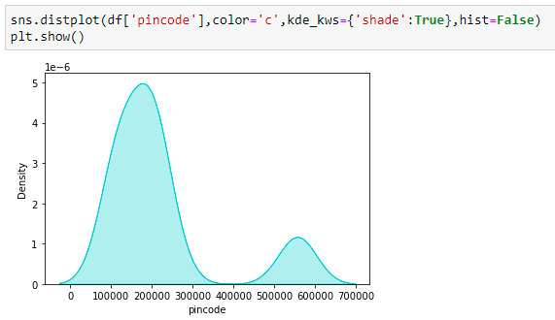
visualizations
Highest number of shoppers/survey responders from Northern Region - Uttar Pradesh and Uttaranchal - 117 in number
Equally high number of shoppers/survey responders from Northern Region - Delhi, Haryana, Punjab, Himachal Pradesh and Jammu & Kashmir - 115 in number
Only 37 shoppers/survey responders from the Southern Region - Andhra Pradesh and Karnataka

Slide 18
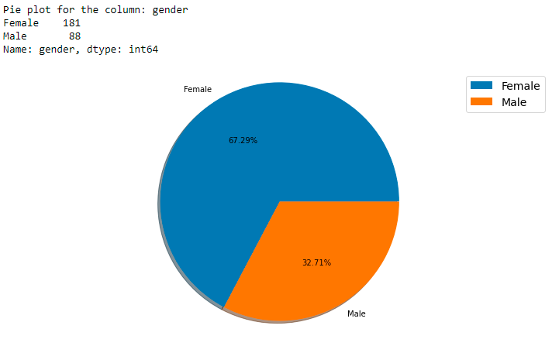
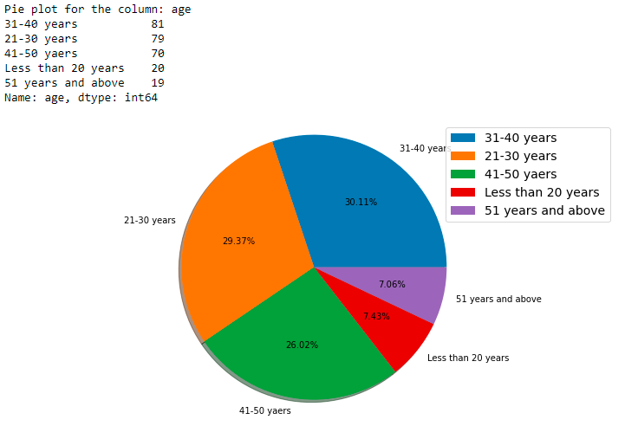
visualizations

Slide 19
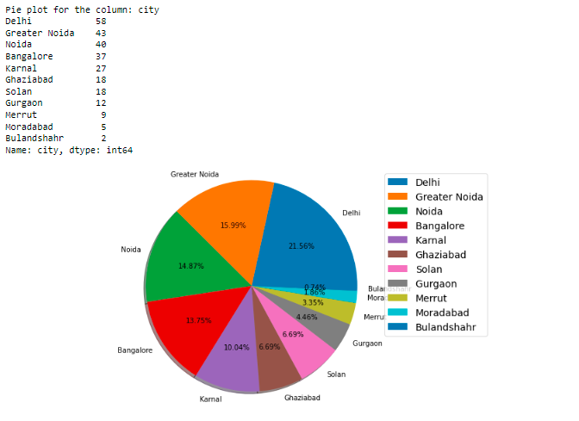
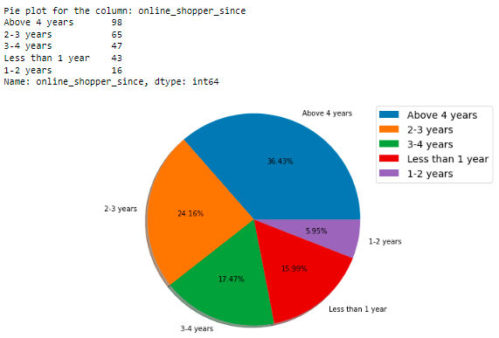
visualizations

Slide 20
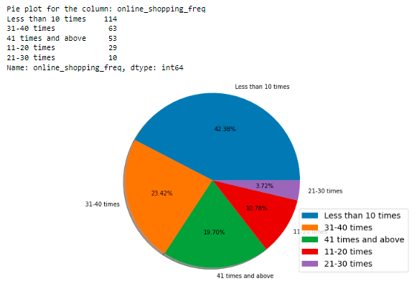
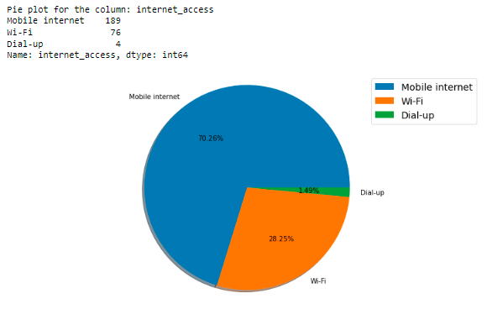
visualizations

Slide 21
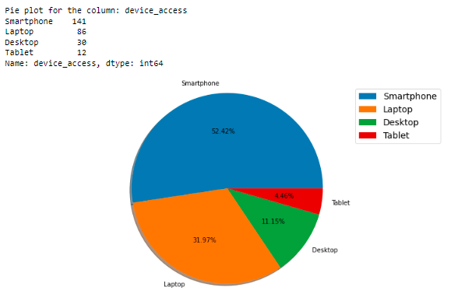
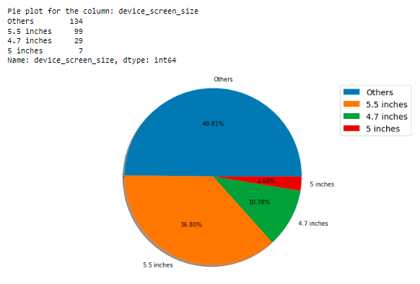
visualizations

Slide 22
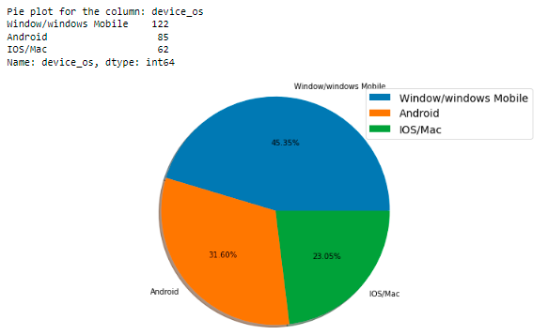
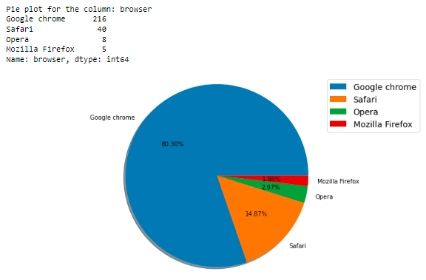
visualizations

Slide 23
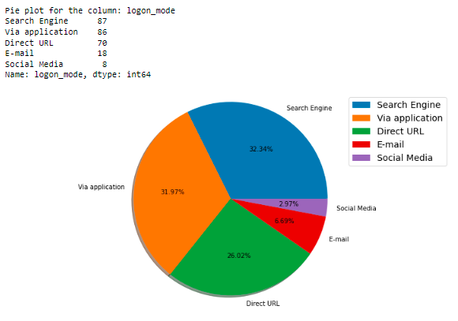
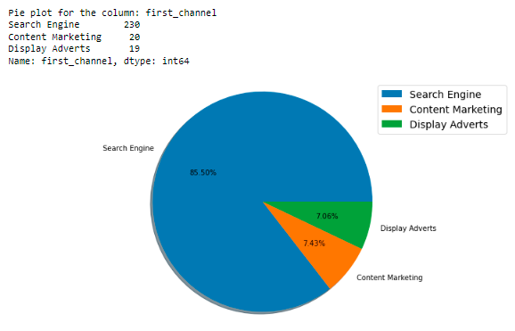
visualizations

Slide 24
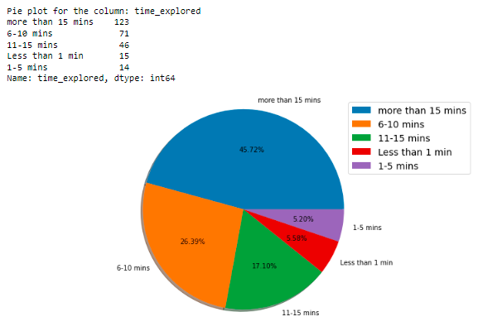
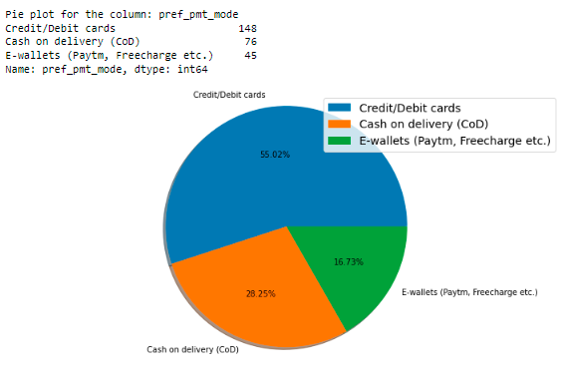
visualizations

Slide 25
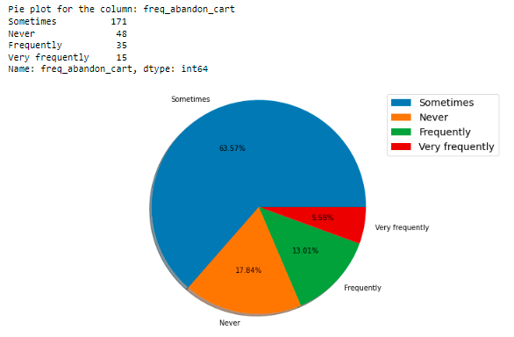
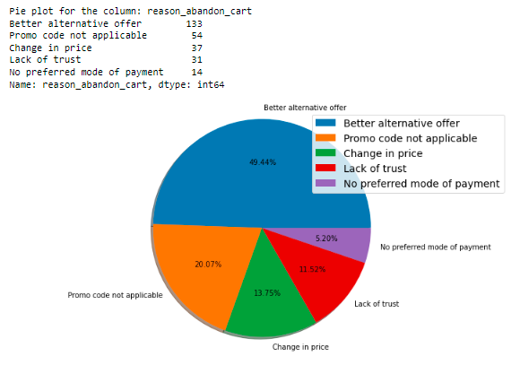
visualizations

Slide 26
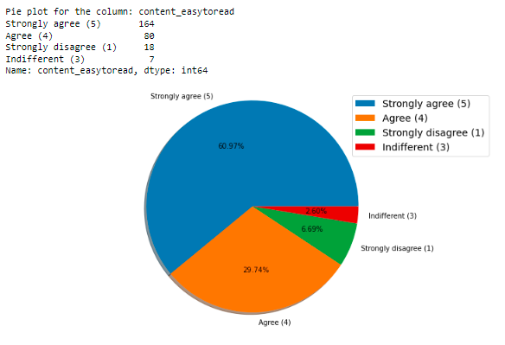
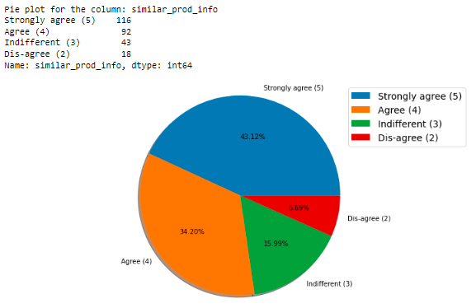
visualizations

Slide 27
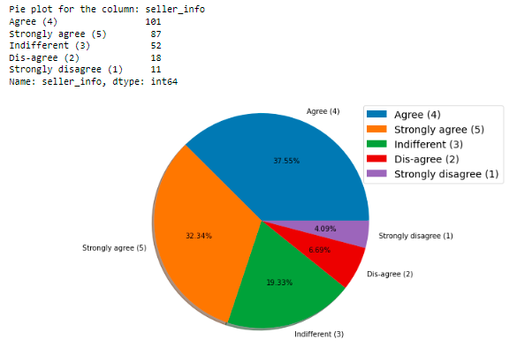
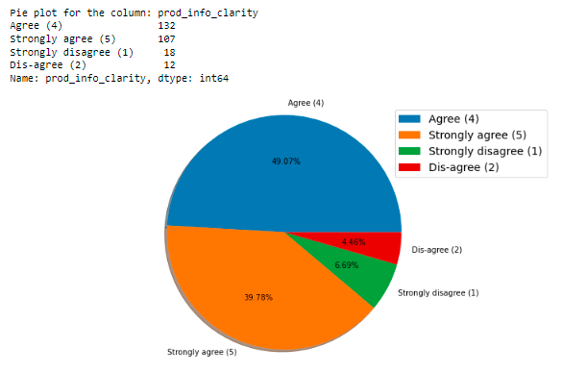
visualizations

Slide 28
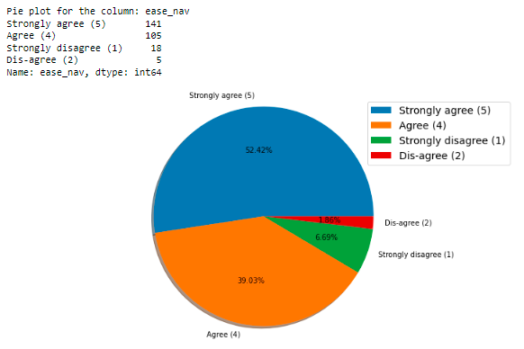
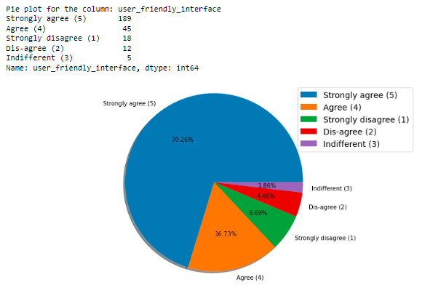
visualizations

Slide 29
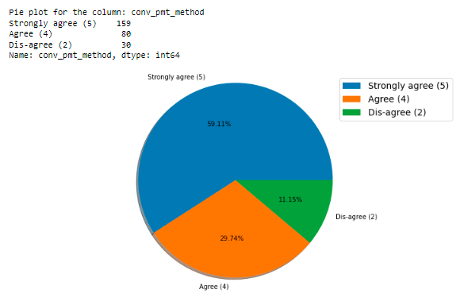
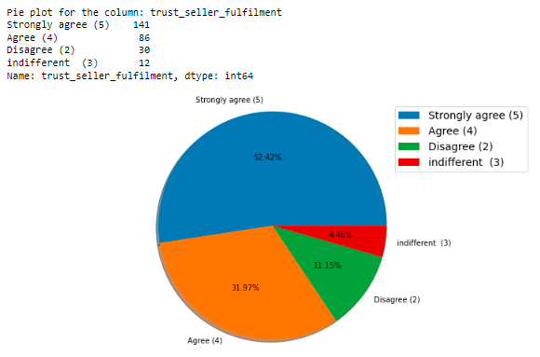
visualizations

Slide 30
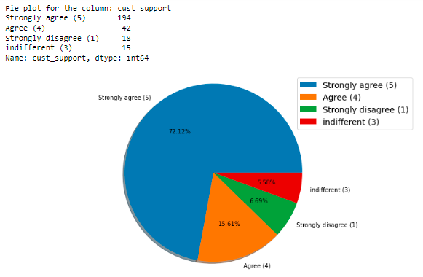
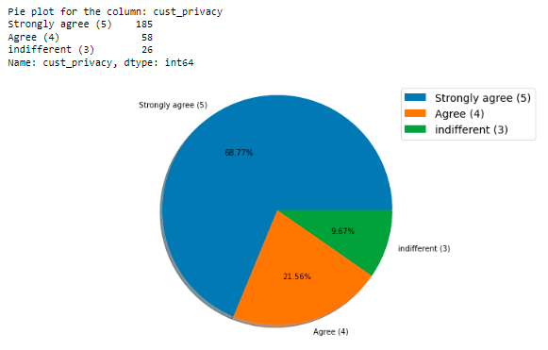
visualizations

Slide 31
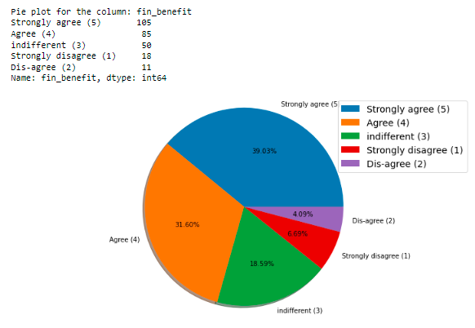
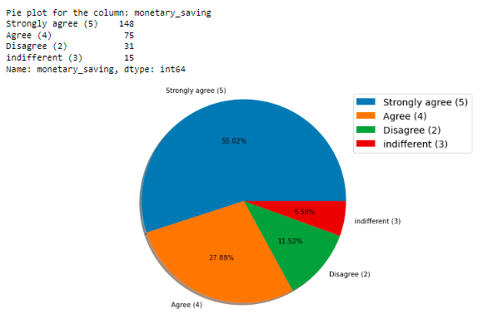
visualizations

Slide 32
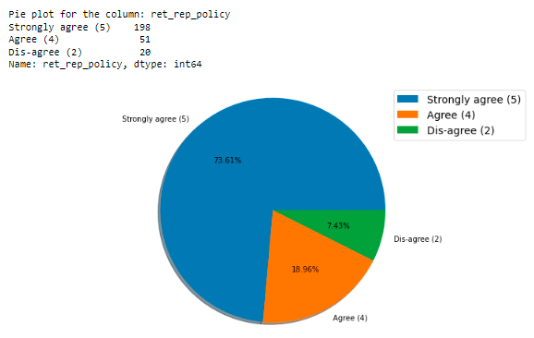
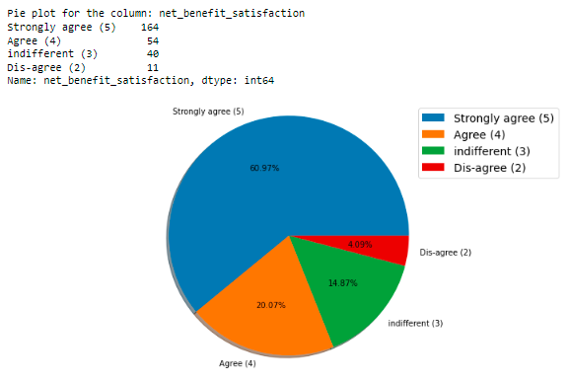
visualizations

Slide 33
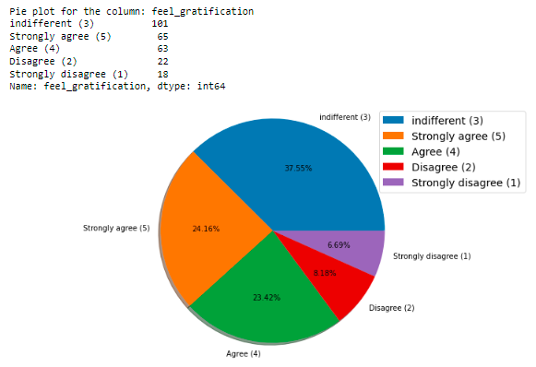
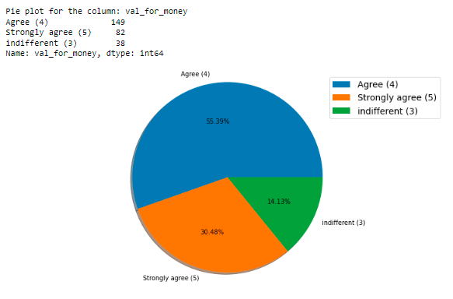
visualizations

Slide 34
Detailed findings
About two-thirds (67.29%) of the online shoppers are female, and one-third (32.71%) are male.
Maximum shoppers in the age group of 31-40 years. Almost equitable distribution of percentage of shoppers in the age groups of 21-30, 31-40 and 41-50. Similarly, there appears to be an equitable distribution across the age groups of less than 20, and more than 50.
Almost 64% of shoppers from Delhi/NCR (Delhi, Greater Noida, Noida, Ghaziabad and Gurgaon), with 13.75% from Bangalore.
More than one-third (36.43%) of the online shoppers have been shopping online for more than 4 years, and about 16% have been shopping online for less than a year.
About 42% online shoppers shop less than 10 times in a year, with about 20% shopping more than 40 times.
About 70% shoppers use mobile internet, followed by about 28% who use Wi-Fi. Less than 2% shoppers still use dial-up connections.
About 52% shoppers use smartphones, with 32% of them using laptops. The remaining use either a desktop computer or a tablet.

Slide 35
Detailed findings
Almost 50% of the shoppers use screen sizes other than 5.5 inches, 4.7 inches or 5 inches. Interestingly, about 37% shoppers use devices with a screen size of 5.5 inches.
Most shoppers use still use the windows OS, followed by Android, and then iOS/MacOS.
About 80% shoppers use Google Chrome, followed by about 15% who use Safari. The remaining use either Opera or Firefox.
Most shoppers (85.50%) arrived at their favorite online store for the first time using a Search Engine. The remaining were directed to the sites through either Display Adverts or through Content Marketing Ads.
About 32% customers use a Search Engine to logon to the online stores after their first visit, with almost an equal percentage of them start using direct applications of the stores, followed by about 26% who use the store’s direct URL.
Shoppers who spend more than 15 minutes on the online store before making a purchase account for 45.72% of the shoppers, and about 11% of them spend less than 5 minutes.

Slide 36
Detailed findings
In terms of payment mode preference, 55.02% prefer Debit/Credit Cards, followed by 28.25% who prefer CoD, and 16.73% who prefer e-wallets.
Almost two-thirds of shoppers sometimes abandon their shopping carts. Interestingly, 18% of the shoppers never abandon their carts (either making a purchase, or never adding items to the cart unless sure).
Almost 50% of the shoppers abandon their shopping carts online because of a better alternative offer. There are about 12% who do so due to lack of trust, on either the seller, or the online store.
More than 90% of the shoppers agree that the content on the website must be easy to read and understand.
More than three-fourths of the shoppers (77.32%) feel that information on similar product to the one highlighted is important for product comparison.
About 70% of the shoppers feel complete information on listed seller and product being offered is important for purchase decision.

Slide 37
Detailed findings
Almost 90% of the shoppers feel all relevant information on listed products must be stated clearly.
More than 90% of the shoppers feel that ease of navigation of the website is an important factor.
About 85% of the shoppers consider loading and processing speed while shopping online.
87% of the shoppers prefer a user-friendly interface of the website, of which about 70% feel it is extremely important. About 2% of the shoppers feel indifferently about it.
Only about 11% shoppers did not feel that convenient payment methods are an influencing factor.
Almost 85% of the shoppers' trust that the online retail store will fulfil its part of the transaction at the stipulated time.
Almost 88% of the shoppers feel that the online store’s readiness to assist with queries plays an important role.

Slide 38
Detailed findings
Only about 10% of the online shoppers felt indifference about a store’s ability to guarantee the privacy of the customer.
An online store’s availability over several communication channels, along with their responsiveness is an important factor for over 90% of the shoppers.
About 70% of the shoppers agree that online shopping gives monetary benefits and discounts, with about 19% feeling indifference on the matter.
More than 50% of the shoppers feel a sense of enjoyment from online shopping, with about 28% feeling indifferently, and more than 18% who do not agree with the premise.
Convenience and flexibility of online shopping is a major decision factor with more than 80% shoppers. There are about 12% shoppers who feel indifference on the convenience aspect of online shopping.
Only 7.43% of the online shoppers feel that return and replacement policy of the e-tailer IS NOT important for a purchase decision.

Slide 39
Detailed findings
Although two-third of the online shoppers feel that access to loyalty programs is a benefit of online shopping, however, a whopping 23.79% of the shoppers feel indifferently about access to loyalty programs.
Almost 80% shoppers believe that displaying quality Information on the website improves satisfaction of customers. The remaining feel indifferently on the matter.
A good quality of the app or website gives satisfaction to over 97% of the online shoppers.
Net Benefit derived from shopping online leads to user satisfaction among 81% of the shoppers, and almost 15% feel indifferently about it.
88.85% shoppers believe that user satisfaction cannot exist without trust.
Offering a wide variety of listed product in several categories is important for more than 75% of the shoppers, and about 21% feel indifferently, while 2.60% disagree with the premise.
Provision of complete and relevant product information is important to over 85% of the shoppers.

Slide 40
Detailed findings
Over 55% of shoppers strongly feel that they experience monetary savings from shopping online, with 27.88% additional shoppers who agree to the premise. Almost 12% disagree with monetary savings from online shopping.
The convenience of patronizing the online retailer is a factor for over 70% shoppers, while the remaining feel indifferent towards the factor.
Shopping on the website gives a sense of adventure to about 58% shoppers, and while about 22% feel indifferently, 20% of them disagree, i.e., they do not feel a sense of adventure from online shopping.
Although a strong number of shoppers (37.17%) feel indifferent about an enhancement of social status from online shopping through their preferred e-tailer, 40% of them do agree with the premise.
Almost 48% experience a sense of gratification by shopping on their favorite e-tailer.
Value for money spent is experienced by about 86% of shoppers, while the rest feel indifferently.

Slide 41
Detailed findings
Based on the countplots visualized based on parameters of website/online store selection preferences of consumers, the following key points were identified:
Most people shopped from Amazon.in, Flipkart.com, Paytm.com, Myntra.com, and Snapdeal.com companies, and they think that it is easy to use the websites or applications of these companies.
Amazon.in and Flipkart.com have high visually appealing web-page layouts compared to others.
48% of the customers say that Amazon and Flipkart show a wide variety of products on their shopping websites compared to other websites. It's important for the companies to show different types of products to gain customers’ rates.
37% of the customers liked Amazon and Flipkart for displaying complete and relevant information about the products.
Around 51 customers say that Amazon.in is a fast-loading website and application and they liked it. About 44 customers liked the web speed of both Amazon and Paytm followed by Amazon ad Flipkart.

Slide 42
Detailed findings
The count is high for Amazon followed by Amazon and Flipkart which means most of the customers liked the reliability of the website or application on Amazon and Flipkart.
Most of the customers like Amazon's quickness to complete the purchase followed by Flipkart and only a few of the customers like the Myntra website.
On Amazon and Flipkart websites there are several payment options available compared to the other shopping websites.
Most of the customers liked Amazon's delivery speed followed by Flipkart and Snapdeal.
Most of the customers trust Amazon followed by Flipkart in terms of keeping the privacy of their data information.
The count is high for the customers who believe that the Amazon website keeps their financial information secret also the customers trust Flipkart, Myntra, Snapdeal, and Paytm in terms of keeping their financial information secured.

Slide 43
Detailed findings
Most of the customers believed that Amazon has perceived trustworthiness compared to others. Apart from this, customers believed that Flipkart and Myntra also have perceived trustworthiness.
Most of the customers like Amazon in terms of the presence of online assistance through multi-channel followed by Flipkart, Myntra, and Snapdeal.
Most of the customers agreed that Amazon takes a longer time to get logged in.
Customers believe that Amazon and Flipkart take a longer time to display the graphics and photos during the sales period.
Customers say that Myntra and Paytm have a late declaration of price in the promotion/sales period compared to others.
Also, Myntra and Paytm have longer page loading times.
Snapdeal.com has limited modes of payment on most products, followed by Amazon.in.
In terms of time taken in product delivery, Paytm has the highest count followed by Snapdeal.com.

Slide 44
Detailed findings
Most of the customers disliked changes in website/Application design on Amazon, followed by Paytm.
Most of the customers disliked frequent disruption when moving from one page to another on Amazon, Myntra, and Snapdeal.
Most of the customers believe that Amazon and Flipkart's website is as efficient as before.
Most of the customers would like to recommend Amazon retailer to a friend followed by Flipkart.

Slide 45
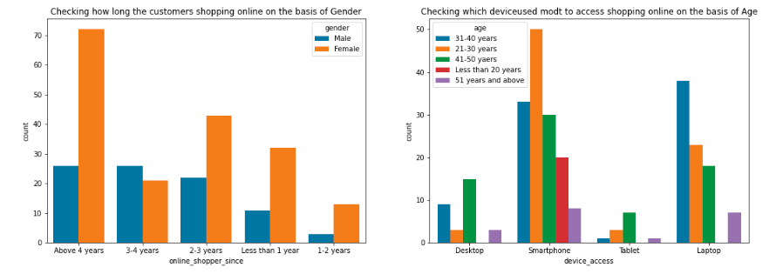
visualizations

Slide 46
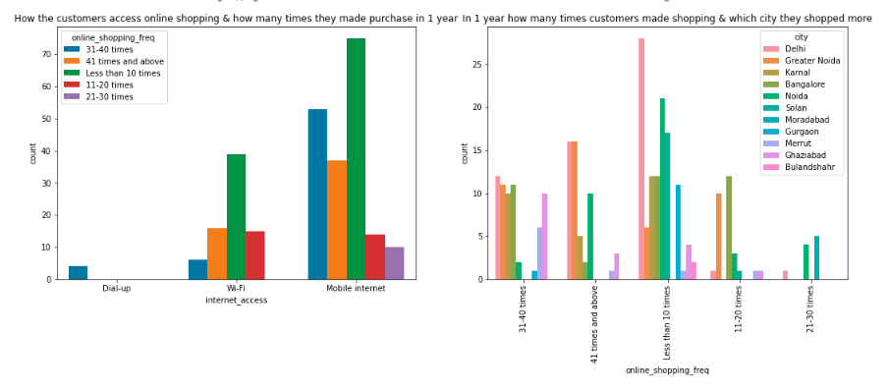
visualizations

Slide 47
findings
Most of the female customers have shopped online for more than 4 years and the count is also high for the females who shopped from 2 to 3 years. And only a few male customers have shopped online for more than 4 years.
Many of the customers access the shopping websites more than 31-40 times in 1 year through Mobile Internet to shop the product also most customers who used mobile internet to access the online shopping website made online purchase less than 10 times in a year. And only a few of the customers used a Wi-Fi network to access the shopping store.
Most customers used e-commerce websites less than 10 times a year from the city of Delhi to shop for the products.

Slide 48
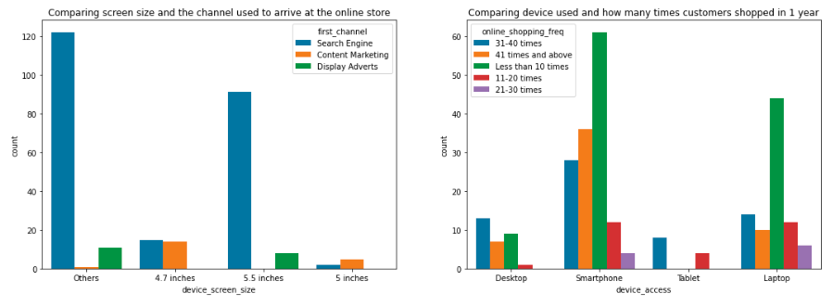
visualizations

Slide 49
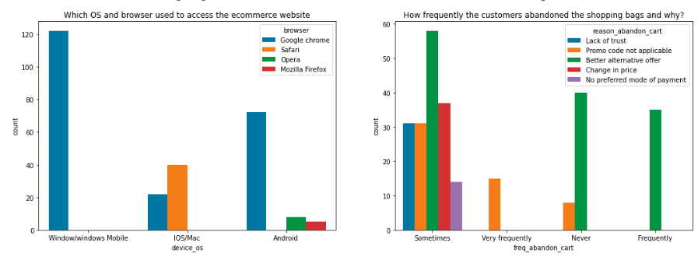
visualizations

Slide 50
findings
The customers having their mobile screen size say 6 inches(others) have followed search engine channels to arrive at their favorite online store for the first time. The customers who have a screen size of 5.5 inches also used search engine channels to access the online shopping store.
Most customers used Smartphones 31-40 times a year to access the eCommerce websites to shop the products.
Many customers having windows operating system on their device ran Google Chrome to access the eCommerce shopping websites and some of the customers having IOS/Mac operating system used Google chrome as well as Safari to reach the online shopping store.
Due to a lack of trust in the eCommerce websites, sometimes most of the customers abandoned the websites and some of the customers abandoned the shopping website due to the promo code not being applicable. which means, if the product is having a special price or some catalog price rule applies to it. Then coupon codes should not apply to the products.

Slide 51
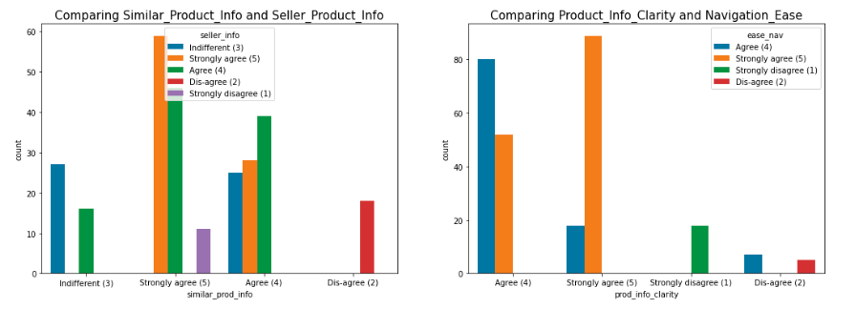
visualizations

Slide 52
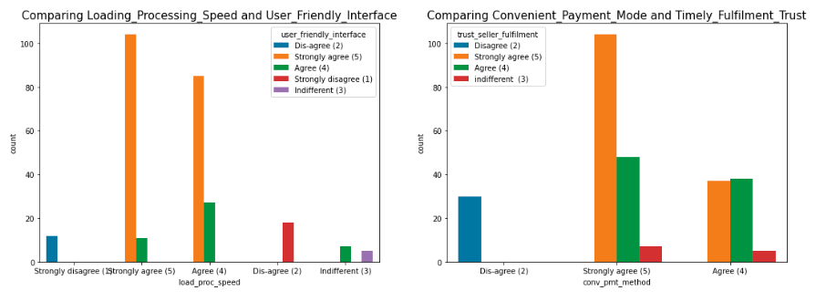
visualizations

Slide 53
findings
Almost all the customers agreed that e-commerce websites have empathy for them and can protect their privacy. That is, online retailers must be able to answer all their customers' questions, and they must assure them that all their credentials are secure and should not be shared with others. Customers will shop more frequently if websites guarantee their privacy. This will increase the company's sales.
Most customers agreed that online shopping provides monetary benefits and responsiveness, as well as the availability of multiple communication channels, which means that if one channel is unavailable, customers can easily reach out to another channel to fulfill their benefits. As a result, online e-tailer companies must provide multiple channels of communication with their customers.

Slide 54
findings
The eCommerce websites should solicit feedback on their services, product ratings, reviews, and so on, and they should also attempt to communicate with customers on various social platforms; only then will customers be satisfied with the e-tailer's sites and make more purchases on the specific websites regularly, thereby increasing the company's sales. Customers are more likely to shop at a website that offers a lower price and a larger discount on a specific product. As a result, companies must try to offer lower prices so that customers like their offers and retention increases.
Most customers believe that they enjoy online shopping and that it is convenient and flexible. However, some customers disagree that they enjoy online shopping and that it is not convenient for them. Some customers shop online just for recreation; they are referred to as hedonic; for them, shopping online provides experiential satisfaction. They make significant contributions to e-commerce companies by purchasing all the expensive products at random.

Slide 55
findings
Most customers agreed that the e-return and replacement policy is important for purchase decisions and that having access to loyalty programs is an advantage of shopping online. Many return policies have conditional agreements, such as time limits, that must be clearly defined and expressed at the time of purchase, or else customers will not have the opportunity to return their damaged or dissatisfied products, and they may not be able to access the same website if they want to shop again. It is clear from the fact that the customers do not like the products completely; they simply purchase them and return them if they are dissatisfied. As a result, if online shopping websites want to keep their customers, they must have an easy return and replacement policy. Furthermore, by gaining access to loyalty programs, customers receive increasingly more rewards, increasing their engagement rate and, as a result, bringing more profit to both the company and the customer.

Slide 56
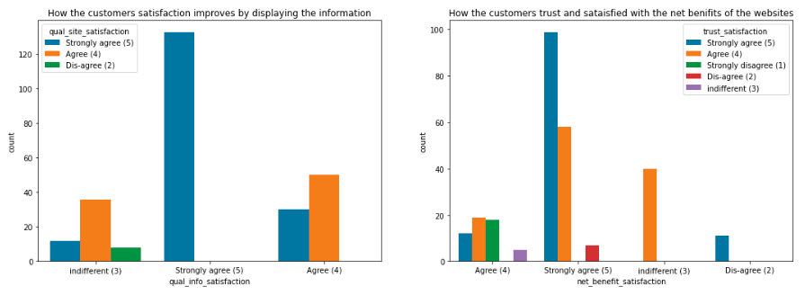
visualizations

Slide 57
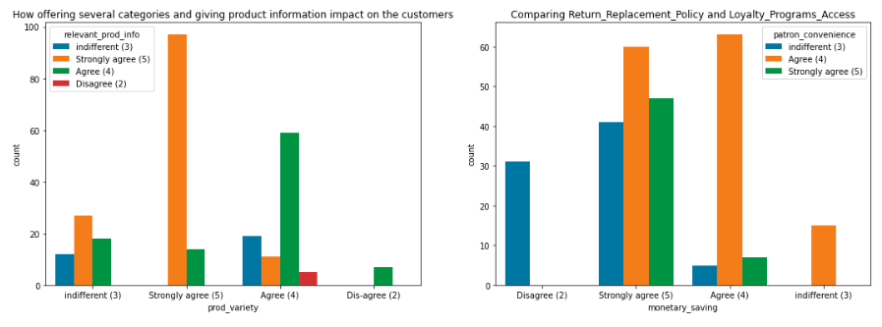
visualizations

Slide 58
findings
Many customers agreed that displaying quality information on the website improves customer satisfaction because they believe that displaying quality information has a significant association with customer satisfaction and that they are satisfied and happy when shopping on good quality websites. High levels of customer satisfaction necessitate high levels of service quality, which frequently leads to favorable behavioral intentions. A website with good system quality, information quality, and electronic service quality is also essential for e-commerce success. As a result, online e-tailers must display all product information so that customers are enticed to purchase the products regularly.

Slide 59
findings
Most customers believed that the net benefit obtained from online purchasing can lead to user pleasure and that user satisfaction cannot exist without trust. The e-tailer could offer crediting points (net advantages) to encourage clients to purchase regularly to accumulate points. Customers use the trust to determine whether to buy things from online retailers. Trust also helps to eliminate ambiguity when the customer's familiarity with the transaction security mechanism is insufficient. Customers that have a high level of trust in a website are more likely to make a purchase, thus an ecommerce website must earn that trust.
Customers are more likely to buy from the same website if it has a large selection of products in several categories and provides useful information about the products. Having many product lines can help an ecommerce business flourish, and accurate and up-to-date product information must be clearly presented on the website so that people can buy the products without being confused.

Slide 60
findings
Everyone wants to save money in this digital and competitive world, so e-commerce businesses must understand that the easiest method to sell online is to make the customer believe he is saving money. Not only should consumers feel good about purchasing online, but they should also save a lot of money. For the seller, these savings would be automatically turned into trust and brand equity. To accomplish this, online businesses should use social media channels to provide consumers with the finest prices and bargains. Customers can save money if businesses offer discounted prices, and they are more likely to shop at the same websites frequently. Most customers felt that convenience is the most significant factor in e-commerce.

Slide 61
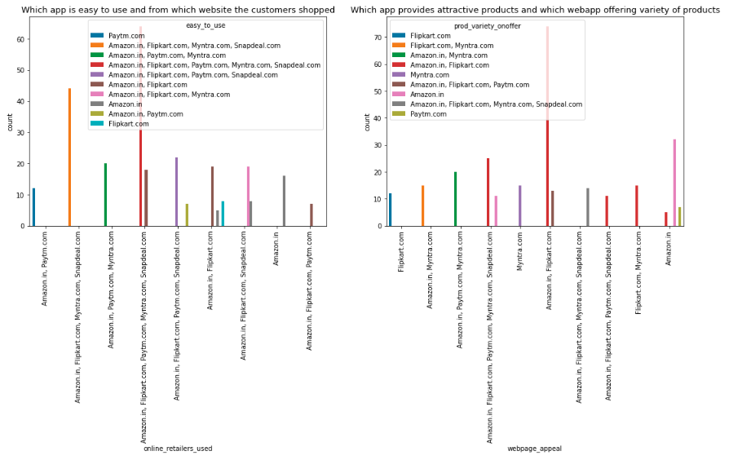
visualizations

Slide 62
findings
Various websites offer things, including Amazon.in, Flipkart.com, Paytm.com, Myntra.com, and Snapdeal.com, all of which are simple to use and shop on. Most customers used these websites more frequently because they may offer lower-cost products, good discounts, and a large variety of identical products from various brands.
In comparison to other websites, Amazon and Flipkart have a visually appealing web page layout, which means that both websites feature some colorful images on the homepage. The more individuals who find a website appealing, the more likely they are to stay a little longer on that website; also, these websites offer a wide range of products in an appealing style, causing clients to purchase the product.

Slide 63
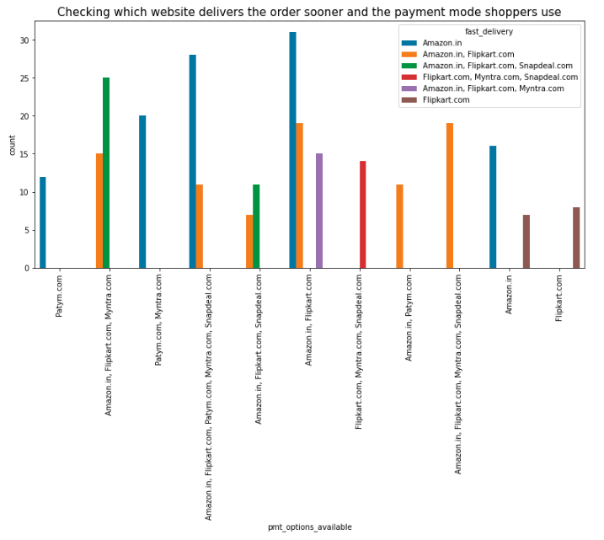
visualizations
Having a variety of payment methods allows customers to pay their invoices easily using their preferred method of payment, and if the websites have quick delivery methods without a delivery charge, customers are more likely to purchase products from those websites.
Amazon and Flipkart both accept a variety of payment methods, and Amazon does deliver orders faster than other websites.

Slide 64
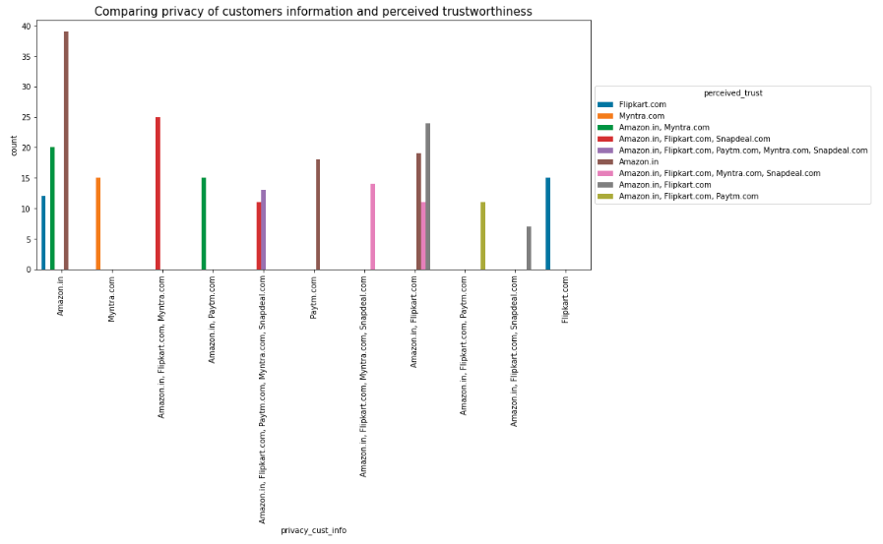
visualizations

Slide 65
findings
Security and privacy refer to the security of credit card payments as well as the privacy of shared information such as the customer's name, address, and phone number. Customers are always concerned about whether or not the website will protect them from fraud after a transaction. As a result, website security and privacy are critical when evaluating the service quality of online stores. Customers believe that buying online entails taking a risk; in this case, trust is more important for both the merchant and the customer.
Most customers trust Amazon, followed by Flipkart, to keep their data privacy secure, and customers who believe that Amazon's website keeps their financial information private also trust Flipkart, Myntra, Snapdeal, and Paytm to keep their financial information secure. When compared to others, the majority of customers believed that Amazon has a higher perceived trustworthiness. Aside from that, customers believed flip kart and Myntra had a high level of trustworthiness.

Slide 66
outcomes
We examined ecommerce quality in online businesses and developed new knowledge to better understand the most critical characteristics of the e-retail factor for client activation and retention in this project.
This research aims to improve previous knowledge on how ecommerce websites effect customer happiness, trust, and behavior, such as repurchase intent, loyalty, and site revisit.
Dimensions such as product information, convenient payment methods, trust, fulfilment, website design changes, security/privacy, and many others had a positive impact on ecommerce websites for customers.
Furthermore, some features, such as ease of navigation, loading and speed, late delivery, and so on, had no effect on the ecommerce websites. As a result, a company must pay closer attention to these features and seek breakthroughs that can improve its performance and e-service quality.
Customer satisfaction and trust emerged as outcomes of the overall e-commerce factor. The study's findings indicate that the e-commerce factor has a positive impact on customer satisfaction. According to most research done on the e-retail factor; customer satisfaction is the most important determinant influencing the e-retail factor.
It lends credence to the notion that there is a strong link between e-commerce and customer satisfaction. Customer trust increased as a result of the e-commerce factor. Customer trust increases as a company's retail factor improve. Customer satisfaction and trust are increased when services are of high quality.

Slide 67
According to the findings of the preceding analysis, the prime motives or factors that attract customers to do online shopping and the main reasons or obstacles that discourage consumers from shopping online. As a result of the analysis, it is discovered that most respondents use the internet daily, but most respondents do not use the internet daily to purchase products. Almost half of all respondents said they would only use the internet to buy products if they had to.
outcomes

Slide 68
Assumptions and recommendations

Slide 69
Assumptions and recommendations
Based on the findings and analysis, the following assumptions are presented to online sellers to increase the popularity, convenience, reliability, and trustworthiness of online shopping.
1. The primary concerns of online customers purchasing products or services online are transaction security and consumer data safety. As a result, by improving their technological systems, online vendors can reassure their customers by providing personal information privacy, a protection policy, and a guarantee for transaction security.
2. Receiving customer feedback is an important step in improving the company's sales. The e-tailer wants to keep the customer happy in order to build a successful business, but they frequently fall into the trap of assuming that the customers will provide feedback without being asked. If e-tailers make a mistake, most customers will not complain; instead, they will shop somewhere else. As a result, it is critical to inquire as to how customers truly feel about their products and services.
3. Retailers should be wary of the vexing aspects of online shopping, such as the inability to access the website, lengthy delays in completing online orders, inconsistencies in the items available online, errors in filling orders, and the fuss of returning goods.
4. Online sellers may be more concerned with delivery times, shipping costs, and product return policies. They can make it easier, faster, and more reliable for customers to enjoy the online shopping experience and return to specific websites regularly. The respondents believed that product mixing or finding different products at the delivery time was the main impediment to online shopping, so sellers must be extremely cautious when it comes to delivery.

Slide 70
conclusions

Slide 71
conclusions
The goal of this study is to distinguish the motivators for online shopping and which e-retailer customers are most likely to shop at.
The analysis revealed that consumers' purchasing decisions were influenced by a variety of factors. All these factors encourage customers to buy products online. According to consumers, the primary motivating factor for shopping online is "saving time."
Other motivating factors for online shopping include "information availability," "open 24/7," "huge range of products/brands," "reasonable prices," "various offers for online products," "easy ordering system," and "shopping fun." Respondents' main barriers to online shopping include "online payment system," "personal privacy or security issues," "delivery delays," and "lack of personal customer service."
Following the visualization of the data, it was discovered that Amazon is the best online store where customers trust to buy products, and it has a positive impact on the customers. Customers' expectations have also risen as a result of Amazon and Flipkart. As a result, they are the best online retailer that creates loyal customers and satisfies customers.
It was also discovered that some consumers do not trust and rely on online shopping because of the online payment system and personal privacy.
Furthermore, consumers are concerned about online security, particularly in terms of fraud, privacy, and hacking. As a result, the organizers should set up their organization to increase sales.

Slide 72
THANK YOU
Sahil Kumar
sahilshoppingcart@gmail.com
https://www.linkedin.com/in/consult-sahil-kumar/

